Slide 1
Project Report
Quality Control with AI
这个名称待定

Slide 3
1 Introduction: Company & Product

Slide 4
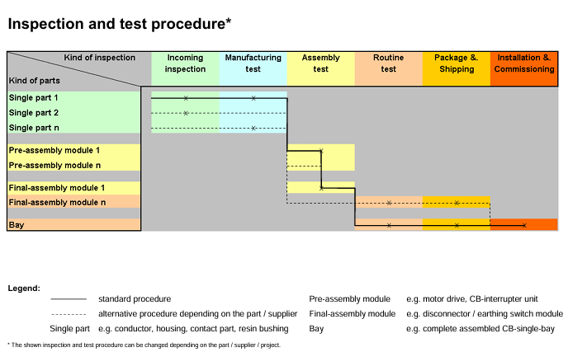
1 Introduction: Quality Control in the Company
Incoming Inspection
Manufacturing Test
Assembly Test
Routine Test
Package & Shipping
*Installation & Commissioning

Slide 5
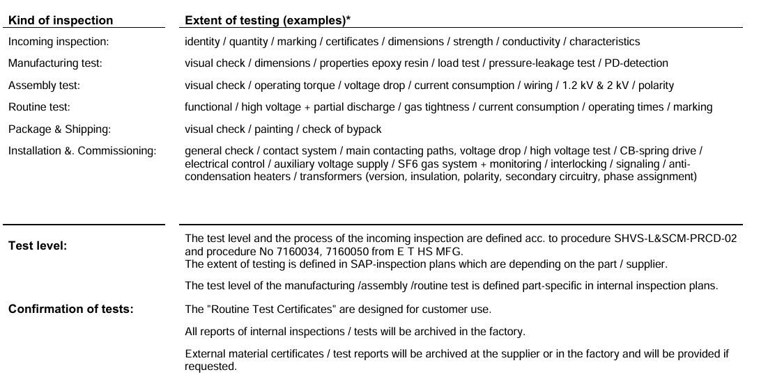
1 Introduction: Quality Control in the Company

Slide 6
1 Introduction: Vision for Digitalization and AI Usage
Office Operation(OA) in generating Quality Reports
Image-based automatic product inspection with Machine Vision

Slide 7
1 Introduction: Current Project
Topic: Final Control Report (FCR) with Rokid Glasses
Target:
1 Automation in creating the FCR
2 Image capture with the help of the glasses

Slide 8
2 Background: Final Quality Control
Process FQC
Final quality gate before packaging and shipping, mainly focused on 外观apperance（构型Structure，标识Label），油漆Painting，包装Bypack
Final Control Report (FCR) as a record of inspection and will be archived for 25 years.
Problem record in process is still done manually.
Knowledge from experts.
Inspection objective
Inspection items

Slide 9
2 Background: Final Quality Control
Workflow
(Arrival of devices in final control area)
|
Start inspection
|
Problems?
yes: 1 photo record 2 problem record + description 3 problem report to FQC Team *report to responsible department in Jiandaoyun? 4 solution applied 5 problem recorded in monthly report
|
Release
|
1 Fill in FCR (by hand)
2 Fill in Project Progress Report (Excel)
|
Archive

Slide 10
2 Background: Rokid Glasses
Function:
Camera
Microphone
AI Agents
Development Platforms:
Rizon (low-code platform for workflow and AI agent)
AIUI Studio (UI)
SDK (Commercial vs Enterprise, S vs M vs L)

Slide 11
3 Project Progress: Demo
Videoclip + Excel + FCR
可以多分几页，放清楚一点

Slide 12
3 Project Progress: Workflow

Slide 13
4 Future Work

